Slide 1

Crime Data Analysis Using Regression Algorithms
Siddharth Mandgi
Abhishek Lokam

Slide 2
What We Have Done
Taking a crime data set and predicting the victim descent and victim
We have a data set for crime from 2011 to 2018
From this data set we extracted data for 2017 and 2018
Then we cleaned the data set
Prediction of Victim Descent and Victim Sex

Slide 3
Optimization Model
We took four algorithms namely:
1) Linear Regression
2) Decision Tree
3) Random Forest
4) Bagging
Predicted the Victim Descent using these four algorithms

Slide 4
FLOW OF OUR PYTHON CODE

Slide 5
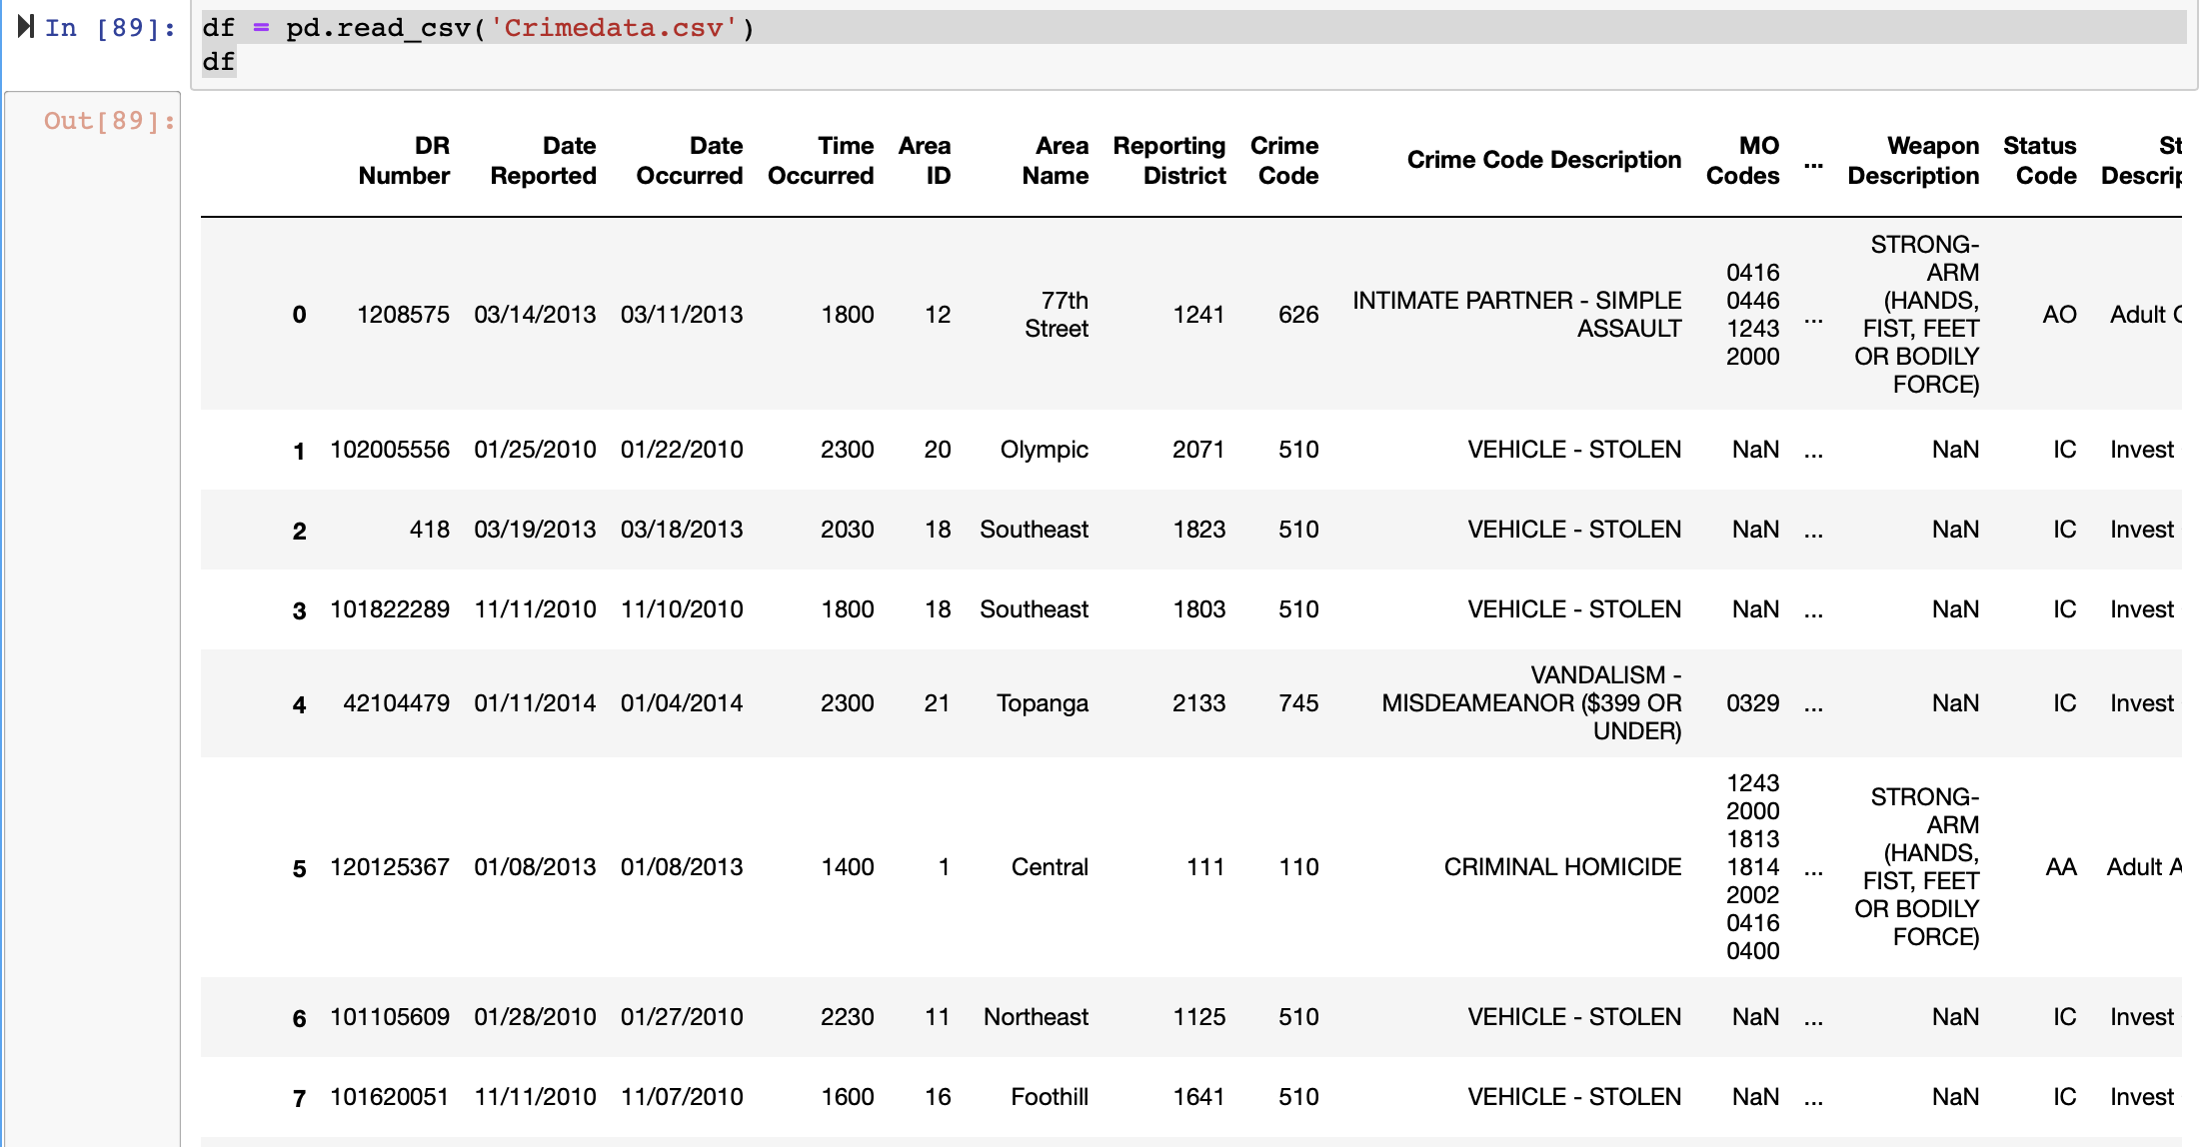
Importing Data
Importing Crime Data Set for all Years from 2011 -2018

Slide 6

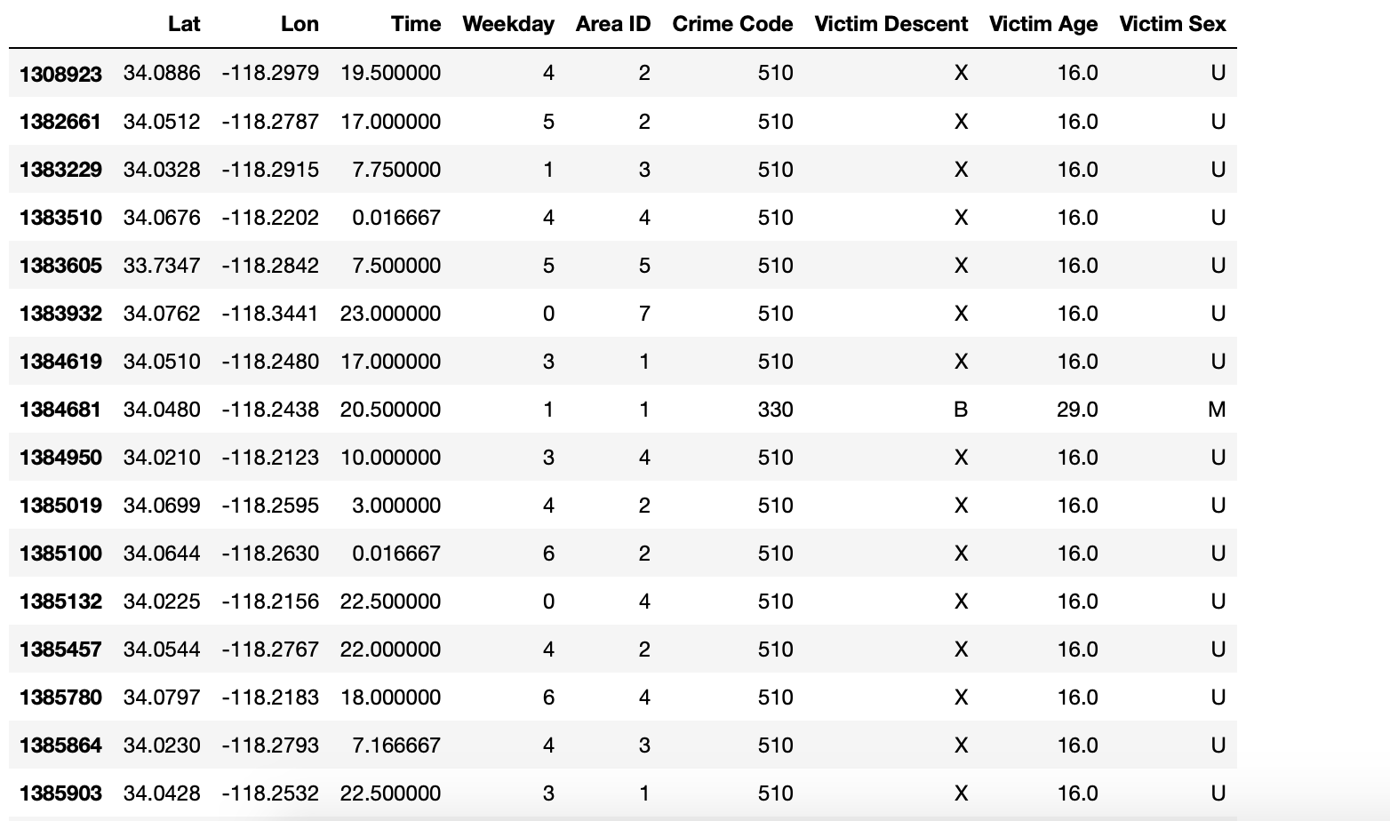
DATA FILETRING
Next we clean the data set

Slide 7
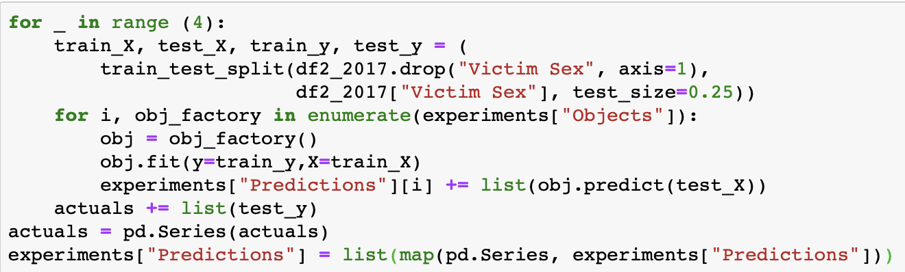
PREDICTION
We then try to predict Victim Sex Or the Victim Descent using four algorithms linear regression , Random forest , Decision Tree and Bagging

Slide 8
RESULTS OF Our Analysis

Slide 9
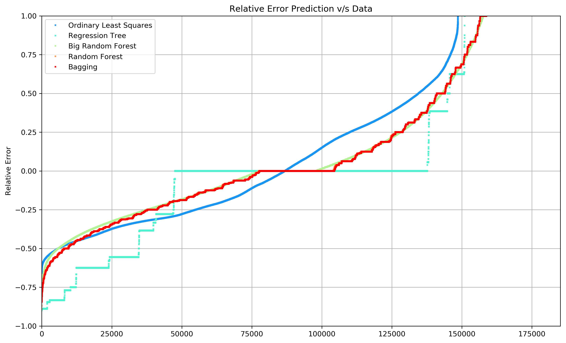
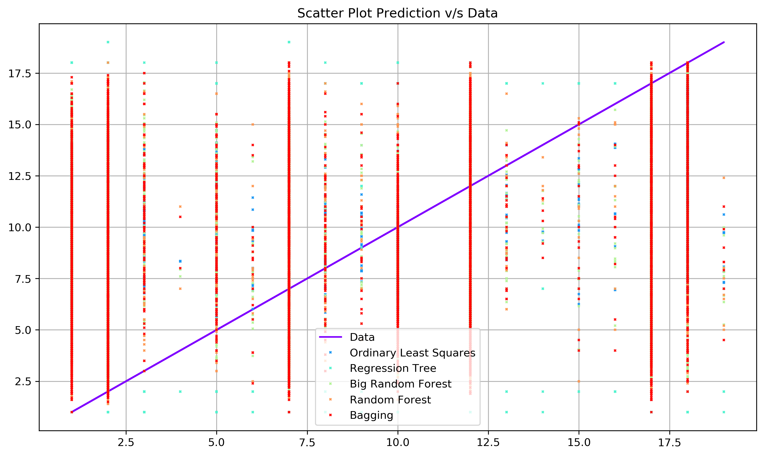
Results
Victim Descent Analysis and Prediction : 2017

Slide 10
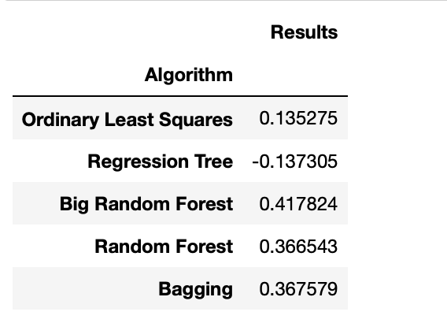
Results

Slide 11
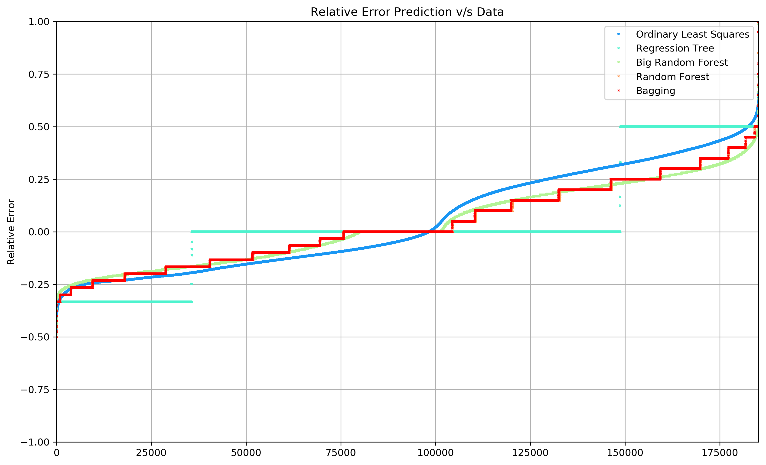
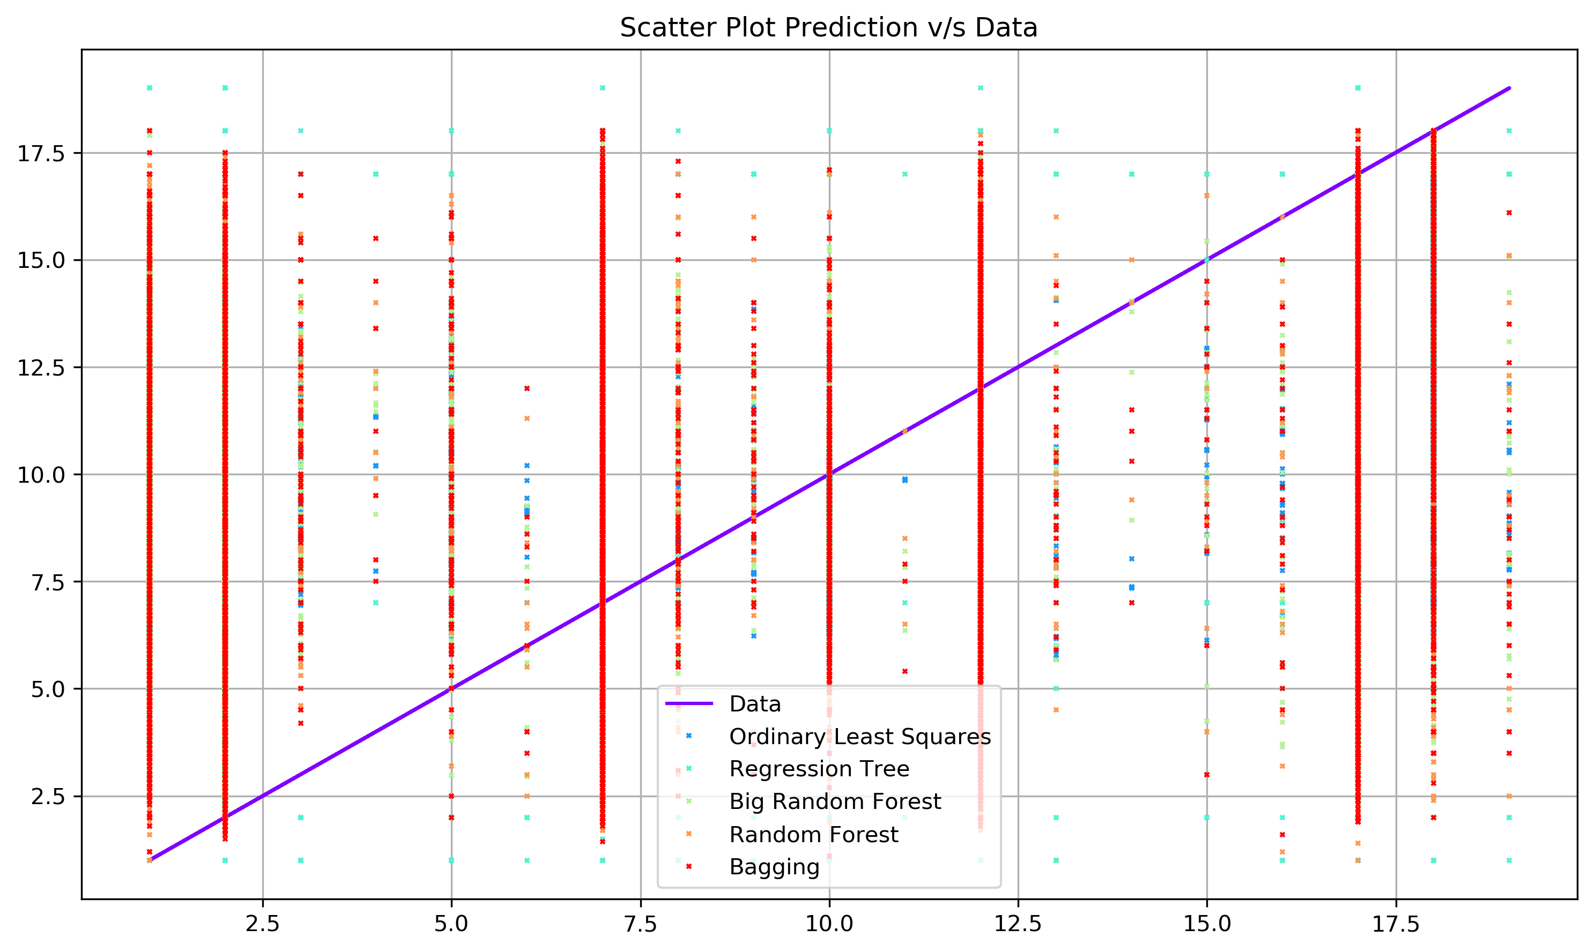
Results
Victim Descent Analysis and prediction for 2018

Slide 12
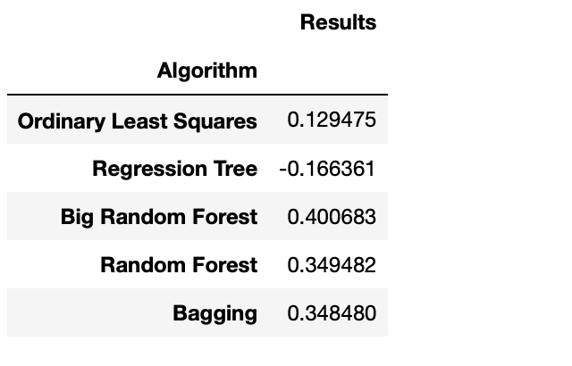
Results

Slide 13
CONCLUSION
While comparing all four algorithms while analyzing the crime data set , We find that Big Random Forest yields the best results with the best accuracy
As we increase the estimator values in Random forest algorithm the accuracy increases.

Slide 14
THANK YOU

